Slide 1
Recruitment/Staffing
Human Resources & Organizational Management Branch (HROM)
Notes:
Notes for your discretion:
Good morning. My name is [Name]. I am a Human Resources Specialist on the Recruitment & Staffing Team located at [location]. Our organization has HR Specialists that service Marine Corps Commands world-wide. So ‘Welcome!’ – no matter where you are joining in from.

Slide 2
What we do…
  Recruitment
  Pay setting
  Entrance on Duty
  Classification
  Labor & Employee Relations (LER)
  Organizational Structuring
  Personnel actions
Notes:
Notes for your discretion:
Recruitment and Staffing Team coordinates vacancy announcements and job offers.
Pay is set in accordance with regulations.
Conduct entrance on duty
Provide advice and training to supervisors and managers on writing positions descriptions and recommendations on organizational structuring
Advise on supervisor to employee ratios; making sure the structure has career paths from entry to senior level positions
Coordinate the processing of personnel actions; also known as an SF-50.
The HROM team includes 5 sections. This is your servicing HR Office. Most Commands and Staff Agencies will have civilian management analysts or a G/S-1 shop. These Command employees assist with providing the proper documents to the HR team so we can coordinate personnel actions, vacancy announcements, and other actions for required for civilian employees
Your primary POC before you came onboard and for most HR issues w/in your first 90 days.
Classification – typically serves as an advisor to management.
You should review your PD with your supervisor before your performance standards are implemented and on an annual basis thereafter.
LER – Advises management and assists employees with Labor and Employee Relations issues.
Workforce Development – Provides training advice/guidance to organizations and individuals.
*Note: You should have received the guide with your reporting instructions. If you cannot locate it, you can go to our homepage and from the “New Employees” link, locate the “blue” icon to open and save this Guide for your information and/or future use.

Slide 3
Guide for Civilian Marines
Contact List and Systems Quick Reference
Sections:
  Welcome
  Employment and Pay
  Working Logistics
  Responsibilities and Rights
  Work Schedule, Telework and Weather Emergencies
  Federal Benefits
  Performance
  Training and Development
  https://www.hrom.marines.mil/New-Employees/#tab/get-the-guide
Notes:
Notes for your discretion:
This Guide was developed to provide you with information you need as a new employee or transfer from another Agency/geographic location. The Guide contains:
“My Internal Contacts” is for your use. These are the points of contacts within your organization that you should know.
HROM Contact List includes points of contacts for the HROM team, telephone numbers, group email boxes; and websites.
We have included contact information for the Equal Employment Opportunity Office – please see them listed directly under the HROM Front Office.
Systems Quick Reference– Listing of websites for information and updating your personal and work information (e.g., benefits, training). Most of the links to these systems are provided on the HROM website.

Slide 4
Notification of Personnel Action
(SF-50)
Document employment events - appointment, movement between agencies
Establish your employment history - your grades, occupations and pay
Generally stored permanently in your electronic Official Personnel Folder (eOPF)
*Allow 1-3 business days for SF-50 to process.
Notes:
Notes for your discretion:
The Notification of Personnel Action is also known as an SF50.
It is a form that is processed any time anything would change in your HR record
You will receive an SF-50 for your appointment to this position from command civilian manpower analysts or your supervisor.
Allow 1-3 business days for your SF50 to be processed.
You should review your SF-50 and notify HROM of any errors.
Confirm the accuracy of your name, social security number, and date of birth. Errors in these fields can cause problems later for you in filing taxes or retirement.

Slide 5
Standard Form 50 Rev. 7/91
U.S. Offfice of Personnel Management FPM Supp. 296-33, Subch. 4
NOTIFICATION OF PERSONNEL ACTION
1. Name (Last, First, Middle) | 2. Social Security Number | 3. Date of Birth | 4. Effective Date
FIRST ACTION SECOND ACTION
5-A. Code 5-B. Nature of Action 6-A. Code 6-B. Nature of Action
5-C. Code 5-D. Legal Authority
6-C. Code 6-D. Legal Authority
5-E. Code 5-F. Legal Authority
7. FROM: Position Title and Number
6-E. Code 6-F. Legal Authority
15. TO: Position Title and Number
8. Pay Plan 9.Occ. Code 10.Grade or Level 11.Step or Rate 12. Total Salary
13.Pay Basis 16. Pay
17. Occ.
18.Grade or Level 19.Step or Rate 20. Total Salary/Award 21. Pay
Plan
Code
Basis
12A. Basic Pay
12B. Locality Adj.
12C. Adj. Basic Pay
12D. Other Pay
20A. Basic Pay
20B. Locality Adj.
20C. Adj. Basic Pay
20D. Other Pay
14. Name and Location of Position's Organization
22. Name and Location of Position's Organization
EMPLOYEE DATA
23. Veterans Preference
24. Tenure
0 - None
25. Agency Use
26. Veterans Pref for RIF
YES NO
29. Pay Rate Determinant
1 - None 3 - 10-Point/Disability
5 - 10-Point/Other
2 - Conditional
2 - 5-Point 4 - 10-Point/Compensable
6 - 10-Point/Compensable/30%
1 - Permanent 3 - Indefinite
27. FEGLI
Basic only
28. Annuitant Indicator
Ret Enlisted
30. Retirement Plan
FERS and FICA
31. Service Comp. Date (Leave) 32. Work Schedule
Full Time
33. Part-Time Hours Per
Biweekly
POSITION DATA
Pay Period
34. Position Occupied
35. FLSA Category
E - Exempt
36. Appropriation Code
37. Bargaining Unit Status
1 - Competitive Service
3 - SES General
2 - Excepted Service
4 - SES Career
N - Nonexempt
38. Duty Station Code
39. Duty Station (City - County - State or Overseas Location)
40. AGENCY DATA | 41. | 42. | 43. | 44.
 |  |  |  | :
45. Remarks
46. Employing Department or Agency |  |  | 50. Signature/Authentication and Title of Approving Official
47. Agency Code | 48. Personnel Office ID | 49. Approval Date
TURN OVER FOR IMPORTANT INFORMATION
5-Part
1 - Employee Copy - Keep for Future Reference
Editions Prior to 7/91 Are Not Usable After
6/30/93
NSN 7540-01-333-6236
Notes:
Notes for your discretion:
For your reference you can find a copy of the SF-50 in your guide for Civilian Marines on page 22.
Block 15 – Position Title and position description number (first set of numbers will be PD number)
Block 16 – Your pay plan.
Block 17 – Your occupational series.
Block 18 – The grade level for which your pay is set.
Block 19 – The step within the pay plan and grade at which you are paid.
Block 23 – Veterans Preference
Block 26 – Veterans Preference for RIF
Block 31 – Service computation date for leave.

Slide 6
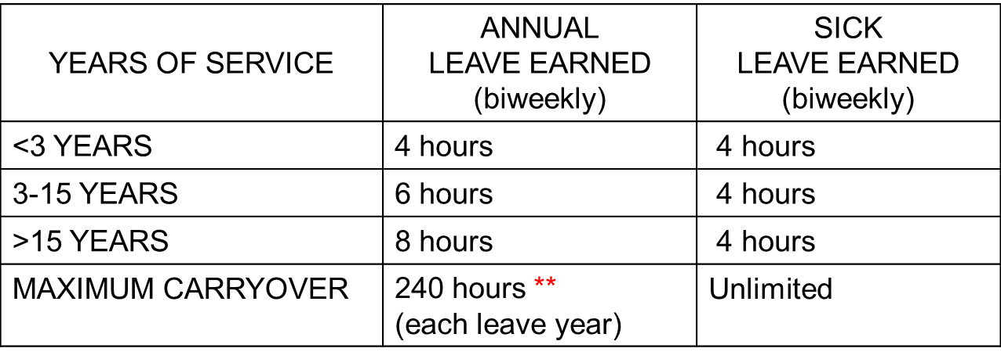
Leave Accrual Rate
** Generally, any amount over 240 hours must be used by end of leave year.
Notes:
Notes for your discretion:
This chart shows you the amount of annual and sick leave you will earn based on years of service.
Based on the number of years of service from your Service Computation Date (Block 31 on the SF-50).
Sick leave is always 4 hours, regardless of number of years of service.

Slide 7
Disabled Veteran Leave
Disabled Veteran Leave (DVL) is only available to veterans who are hired on or after 5 Nov 2016 and who have (or will have) a service-connected disability rating of 30 percent or more. Veterans hired before 5 Nov 2016 are not entitled to this benefit.
Veterans hired on or after 5 Nov 2016 that later are determined to have a service-connected disability rated at 30 percent or more will be eligible for DVL. In such cases, the start date of the 12-month benefit period will be the date the VA claim is filed.
Veterans hired before 5 Nov 2016 that later are determined to have a service-connected disability rated at 30 percent or more are NOT eligible for DVL.
https://www.opm.gov/policy-data-oversight/pay-leave/leave-administration/fact-sheets/disabled-veteran-leave
Notes:
Notes for your discretion:
Hired on or after November 5, 2016
Veteran with –disability rating of 30 percent or more from he Veterans Benefits Administration (VBA)
Entitled to up to 104 hours for the purposes of undergoing medical treatment for such disability.
Receive the appropriate amount of leave as of the employee’s “first day of employment”
Is a one-time benefit provide to eligible employees.
If leave not used it will be forfeited with no opportunity to carry over the leave subsequent years.
May not receive a lump-sum payment for any unused or forfeited leave under any circumstance.

Slide 8
Disabled Veteran Leave
Disabled veteran leave (DVL) is a separate leave category and provides 104 hours (13 days) of leave upfront. Employees can use this leave for service-connected appointments ONLY.
This new leave category is a one-time benefit and is limited to a 12-month period.
DVL not used during the benefit period may not be carried over to subsequent years and will be forfeited.
Once an employee has exhausted the leave benefit and/or the one year has passed, he or she will not have any further entitlements to the benefit.
The leave benefit is a one-time only benefit for the employee’s Federal civilian service career – to include return to federal service after a break in service.
Notes:
Notes for your discretion:
Hired on or after November 5, 2016
Veteran with –disability rating of 30 percent or more from he Veterans Benefits Administration (VBA)
Entitled to up to 104 hours for the purposes of undergoing medical treatment for such disability.
Receive the appropriate amount of leave as of the employee’s “first day of employment”
Is a one-time benefit provide to eligible employees.
If leave not used it will be forfeited with no opportunity to carry over the leave subsequent years.
May not receive a lump-sum payment for any unused or forfeited leave under any circumstance.

Slide 9
Retroactive Usage of Disabled Veteran Leave
The employee did not provide certification of a qualifying service-connected disability before requesting leave.
  For example, Box 23 (Veterans Preference) of the SF-50 is not coded with a 6 (30% or more).
This applies in cases where the employee filed for disability claim with the Veterans Benefits Administration after the hire date (may substitute DVL from date claim filed as start of 12-month eligibility period which could have been coded under DVL)
Notes:
Notes for your discretion:
May be necessary when an employee has a pending claim under review by VBA that is later approved with a retroactive effective date.
Employees should maintain documents or records relating to medical treatment of conditions that may later be covered as a qualifying service-connected disability.
Employees are permitted to retroactively substitute disabled veteran leave for other forms of leaver time off taken for the purpose of receiving treatment for a qualifying disability.
Only for leave or time off was taken during the employee’s 12 month eligibility period for the medical treatment of a qualifying disability.
Cannot be used periods of absence without leave (AWOL) or suspension.
Includes forms such as leave without pay (LWOP), sick leave, annual leave, compensatory time off, or other paid time off.

Slide 10
Military Buyback/Post-56 Deposit
For honorable active-duty Military service on/after 01-01-1957
Criteria for determining buyback eligibility and cost varies, dependent on:
  CSRS or FERS
  Dates of Military service
  Initial start date for Civil Service
The deposit must be paid in full prior to your date of retirement or separation
Must submit the Estimated Earnings During Military Service form (RI 20-97) and DD 214
https://www.opm.gov/retirement-services/fers-information/creditable-service/

Slide 11
Systems
eOPF – Electronic Official Personnel Folder
MyBiz – Employment Verification
Notes:
Notes for your discretion:
On our HROM website, there is a link to electronic Official Personnel Folder (eOPF). All of your SF-50s and other documents related to employment will be in this electronic folder.
Also on the HROM website there is the link for MyBiz.
You can request Employment Verification. Your Human Resources Office and your Command are not authorized to verify employment. This is an automated system where you designate the individual/company that needs an employment verification.

Slide 12
Common Access Card (CAC) and Building Badge
What are these?
How are they different?
Do I need both?
How do I get these?
ID CARD Office Locator
https://idco.dmdc.osd.mil/idco/locator
Notes:
Notes for your discretion:
To obtain your CAC, your SF-50 – Notification of personnel Action must be processed first! This typically takes 1-3 business days after entrance on duty.
NOTE: It may be beneficial to wait until your government email address has been established to minimize the number of trips to the CAC Office. You MAY receive the CAC BEFORE the email address is established. However, you would be required to make a second trip once the email address is established.
Building badges are issued by your respective commands..

Slide 13


Employee Benefits
Notes:
This is brief overview of some of the benefits available to current Federal Employees.

Slide 14
Mass Transportation Benefit Program
Driving and Parking
Parking on many facilities may be extremely limited. Please contact your immediate supervisor or security coordinator to determine if parking is available.
Other Transportation Options
DoD Shuttle Service
DC Metro
Local Bus Systems
Commuter Rail
Commuter Bus
Ride Sharing
Van Pools
Mass Transit Benefit Program (MTBP)
The MTB is an employer-provided mass transportation fare subsidy not to exceed $340/month, that is offered to eligible employees who use mass transportation for their commute.
Notes:
Notes for your discretion:
Local commuting resources/options (getting to/from work)
shuttle services are available between DoD locations in the National Capital Region; shuttle services are also available aboard Marine Corps Base Quantico.
If you use mass transit on a regular/recurring basis to get to/from work, you could be eligible for the Mass Transit Benefit Program.
More information regarding the program and registration for this benefit can be found at the MTBP link which is on our website.
Finally, DUE TO THE COVID PANDEMIC, PLEASE FOLLOW CDC GUIDELINES FOR SAFE TRAVEL.

Slide 15
Mass Transportation Benefit Program Contact Information
Website:
https://mtbp.whs.mil/Participant/Welcome.aspx
Phone Number:
(571) 256-0962
Email:
WHSNCRTransitBenefit@mail.mil

Slide 16
Federal Employee Benefits
There are four main kinds of federal employee benefits available to be paid out upon the death of a federal employee or retiree:
  Thrift Savings Plan (TSP)
  Unpaid Compensation (including any unpaid annual leave, travel vouchers or earned comp time)
  Federal Employee’s Group Life Insurance (FEGLI)
  Lump sum payments from CSRS or FERS

Slide 17
Importance of Beneficiary Designations
An important topic that many federal employees overlook is making sure that their beneficiaries are up to date on several federal benefits.
On the surface, this may seem like just another kind of administrative topic, but there’s actually a lot more to it — such as what benefits are available that warrant a beneficiary, and what your family can expect to have paid out if something should happen to you.
You probably filed your beneficiary designations many years ago, when you were first hired—and for some, that’s 25 to 30 years ago or more.
If you can’t remember who you named, it’s been too long.
Notes:
For those transferring in, if you don’t know who your beneficiaries are, right now is the right time to update your beneficiaries.

Slide 18
Who Should I Name?
The good news is naming a beneficiary or even several beneficiaries is easy.
These forms are super easy, and it’ll probably take you about ten minutes to fill out all four forms, as long as you know who you want to name.
These forms can be completed at any time, so there’s no open season.
You can name anybody that you want as your beneficiary.
  It doesn’t even have to be a living person—it can be an entity like a company, a church, a charity, a cause, a trust, etc.
  You also can name primary beneficiaries as well as contingents.
Notes:
Notes for your discretion:
What can complicate matters is when a former spouse is named as a beneficiary. If your former spouse is still listed as the beneficiary (no matter how long you’ve been divorced or even if you’ve remarried), your former spouse is going to be paid your money when you die. Court cases have gone all the way to the U.S. Supreme Court and have been upheld, so it’s very important to have that beneficiary designation updated.
Another example is that a former spouse could presumably have rights to your money by court order and so they’re first in line. So, let’s say in a divorce decree, your former spouse was supposed to get 1,000 shares of your TSP account upon your death. If, by the time you retire, you have 2,500 shares, then your current spouse (or whoever you name as the beneficiary) would receive the additional 1,500 on top of what the court order has granted to a former spouse. It’s usually not broken out quite that simply in divorce decrees, but that is the idea.
If you’re divorced, the good news is you can name minor children to receive money from all of these different types of beneficiaries (instead of naming your former spouse). The bad news is how minors are treated upon the payout of that money is different between different beneficiary designations.
For example, you could name your spouse as the primary beneficiary, but then have your children as contingent beneficiaries.
I would encourage anybody who has minor children who they wish to be able to leave this type of money to, to consult an estate-planning attorney to ensure that you get things set up correctly. That may mean setting up a trust that allows for minor children to be cared for without the money being turned over, perhaps, to a former spouse or someone else who may step in as the guardian against your wishes. In a trust, you get to dictate who controls that money for the benefit of your children upon your death.

Slide 19
What Happens if I Have a
Trust or a Will?
If you have a former spouse (or anyone else) listed as the beneficiary, they will receive that money regardless of what is stated in your will.
That beneficiary designation will override anything that your will or trust says.
These beneficiary designations are the most powerful legal documents that we can fill out by ourselves.
You must have a couple of witnesses, but you don’t need a notary or any lengthy court involvement.
  You don’t need an attorney.
  You don’t need a judge.
  You don’t need a court order.
  You don’t need any of those things; you can simply update them.

Slide 20
What Happens if No
Beneficiaries are named?
There is a statute called The Statutory Order of Precedence, and it is, by law, the order which your money is to be paid out if you did not indicate on a beneficiary designation who’s supposed to receive it.
If there is no beneficiary named, there is a default order for each form.
The simple task of naming a beneficiary takes the guesswork out of the courts deciding where the money goes.
Better yet, by naming a beneficiary, the money is paid out immediately.
https://www.opm.gov/healthcare-insurance/life-insurance/designating-a-beneficiary/#url=Designation-of-Beneficiary
Notes:
Believe it or not, this happens way too often.

Slide 21
TSP - Designation of
Beneficiary Form
There is a default order of designation for TSP
If you want to elect a different order (from the default) the Form TSP-3 is required
Form TSP-3 can be found at: tsp.gov/forms
OPTIONS FOR SUBMITTING:
Directly Upload – log into your TSP Account and select Upload Form from the menu.
Use office or personal mail to send directly to:
  Thrift Savings Plan
  P.O. Box 385021
  Birmingham, AL 35238
Fax to: 1-866-817-5023
Notes:
Notes for your discretion:
As with the other designation of beneficiaries, there is also a default order for TSP.
If you wish to elect a different order from the TSP default, a form TSP-3 is required.
You can upload online, mail, or fax the forms directly to TSP.

Slide 22
Designation of
Beneficiary Forms
There is a default order of designation (differs between each benefit)
If you want to elect a different order (from the default) a form is required
Forms are available at www.opm.gov/forms
SF-1152 – Unpaid Compensation of Deceased Civilian Employee
SF-2823 – Designation of Beneficiary Federal Employee’s Group Life Insurance (FEGLI)
SF-3102 – Designation of Beneficiary Federal Employee’s Retirement System (FERS)
SUBMITTING:
Use office or personal mail to send ORIGINAL directly to:
  OCHR Norfolk Operations Center
  Attn: Civilian Benefits Center
  Norfolk Naval Shipyard Building 17
  Portsmouth, VA 23709-1005
  Or
  Upload them directly to the GRB Platform at:
  https://civbenefits.dc3n.navy.mil/my.policy
After processing and uploading into your e-OPF, you will receive a copy by mail.
Notes:
Notes for your discretion:
There will be a default order of designation (order may vary between each benefit).
If you wish to elect a different order from the set default, a form is required.
Forms can be found at the OPM website listed on this slide.
This slide also explains the forms and proper mailing address for submitting.

Slide 23
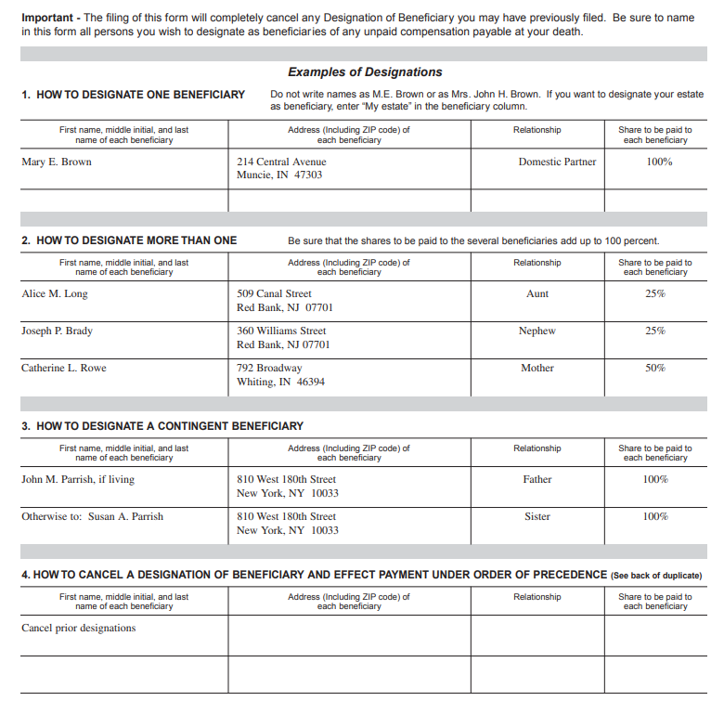
SF 1152, Unpaid Compensation of Deceased Civilian Employees

Slide 24
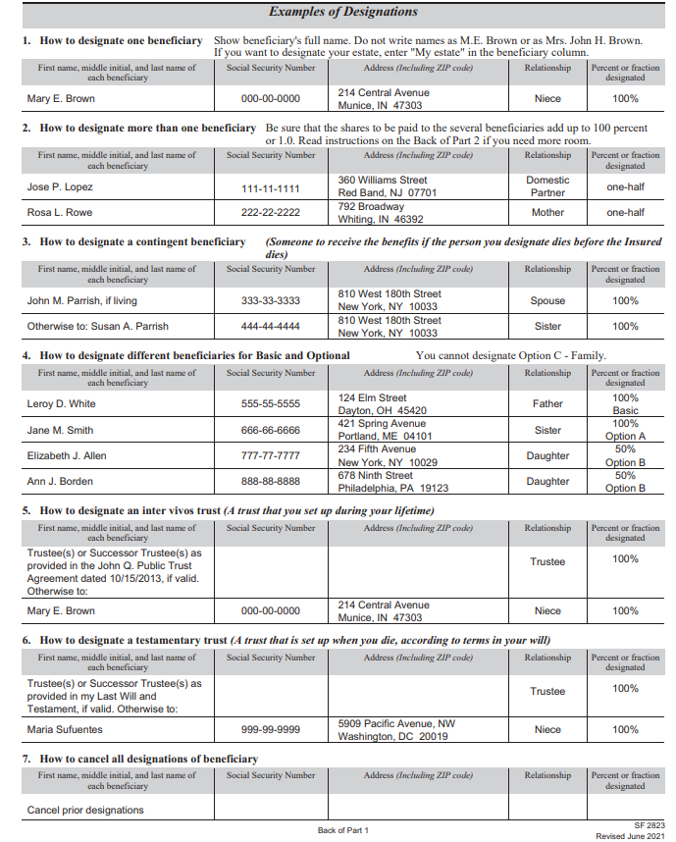
SF 2823, Designation of Beneficiary
Federal Employee’s Life Insurance (FEGLI)

Slide 25
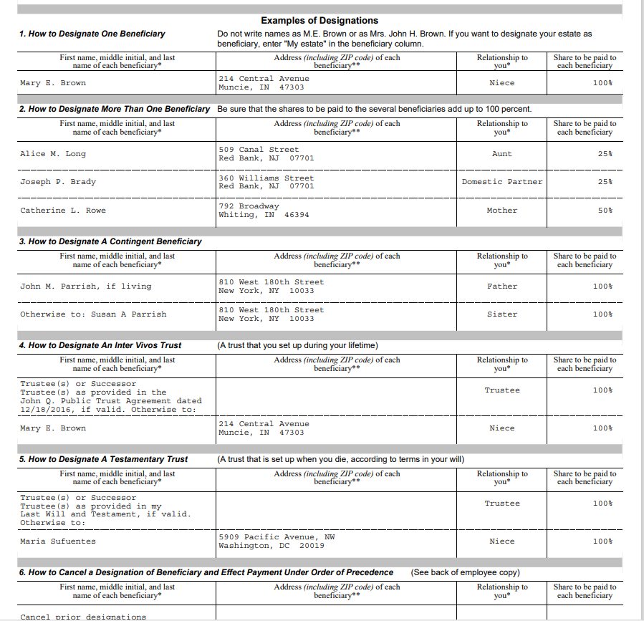
SF 3102, Designation of Beneficiary
Federal Employee’s Retirement System (FERS)

Slide 26
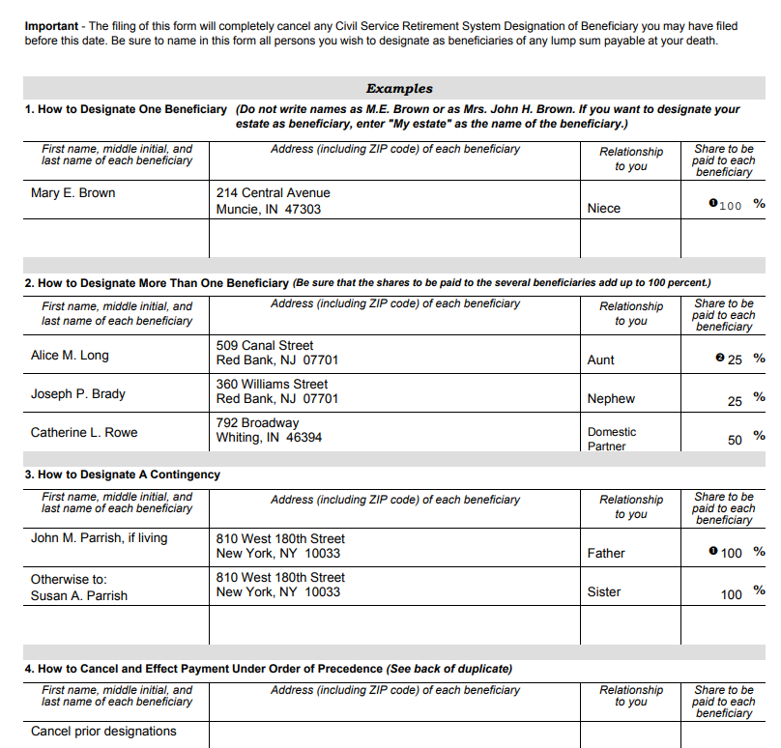
SF 2808, Designation of Beneficiaries
Civil Service Retirement System (CSRS)

Slide 27
Health Benefits After Retirement
You can keep existing health benefits coverage if you meet all of the following conditions:
  You’re enrolled in health care insurance under a federal plan when you retire
  You must have continuously covered by a Federal Employees Health Benefits Program (FEHB) program, Tricare, or Civilian Health and Medical Program for Uniformed Services (CHAMPUS) plan for 5 years immediately before retiring; during all of your federal employment since you first opportunity to enroll; or continuously for full periods of service beginning with the enrollment that started before January 1, 1965, and ending with the date on which you become an annuitant, whichever is shortest.
  Your annuity payments start within 30 days.

Slide 28
Health Benefits After Retirement
~continued
OPM has the authority to waive the 5-year participation requirement when it's against equity and good conscience not to allow an individual to participate in the health care insurance program as a retiree.
  However, the law says that a person's failure to meet the 5-year requirement must be due to exceptional circumstances.
  When someone is retiring voluntarily, a waiver may NOT be appropriate because he or she can continue working until the requirement is met.
If you’re retiring under the Minimum Retire Age (MRA) plus 10 provision of FERS, health care and life insurance coverage are suspended until your annuity starts, even if it is postponed.
Your family enrollment covers yourself, your current spouse, your eligible children who are under the age of 26, and other eligible dependents.
Your eOPF should contain the SF 2809 and/or SF 2810.
When you retire make sure your records show a complete history of your health care insurance enrollment for the last 5 years.
Notes:
These forms are used by Federal employees and other individuals eligible to enroll in Federal Employees Health Benefits (FEHB) Program.
It is used as the official agency or retirement system record of the individual’s coverage and enrollment status under the FEHB Program, re-enroll, elect not to enroll, cancel the enrollment or make changes to the existed enrollment.

Slide 29
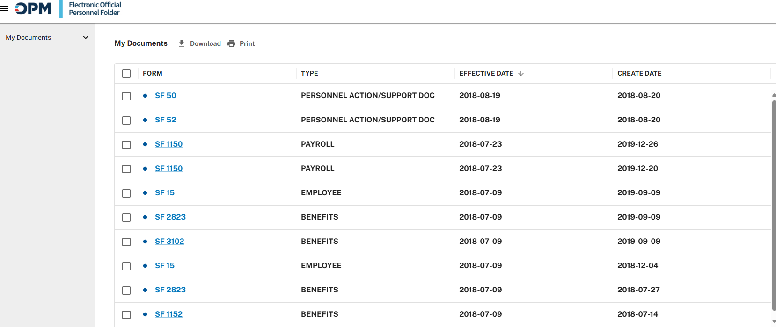
Where to Verify your Current Designation of Beneficiary Forms?
You should have received a copy of your beneficiary forms when the designation was made.
You can also obtain these forms from your eOPF if you don’t have a copy.
https://opf.opm.gov/login/

Slide 30
Be Proactive and Keep
Documents in a Safe Place
Be proactive in naming your beneficiaries and keeping them up-to-date as life changes along the way.
Once you’ve updated them, keep a copy of the beneficiary documents in a safe place, so that your family knows that there is a benefit waiting for them if something should happen to you.
You’ve spent a whole lifetime earning these benefits, so you want to make sure that your loved ones get everything that’s due to them once you pass.
Take the steps necessary to ensure that who you intended to protect receives the money upon your death.

Slide 31
How Can HROM Assist?
The Human Resources (HR) team is available to assist with:
  Printing out the forms
  Signing as a witness
  Assist you with filling out the forms
  Provide you the address on where to mail out the forms
We will not mail out any of the beneficiary forms

Slide 32
DON Benefits Contact
  Website: https://www.hqmc.marines.mil/hrom/benefits/
Civilian Navy and Marine employees who have questions about health insurance, life insurance or Thrift Savings Plan (TSP) can utilize the GRB Platform:
https://civbenefits.dc3n.navy.mil/my.policy
or
You can also send an email to: navybenefits@us.navy.mil
or you can call.
Department of the Navy (DON) Benefits Line at 1-888-320-2917 and select option 4 to talk to a Customer Service Representative (CSR). CSR’s are available from 7:30 a.m. until 7:30 p.m. (Eastern Time). Monday through Friday, except on federal holidays.
Notes:
Here is the Navy Benefits Contact information

Slide 33
Updating / Changing Contact Information
It is pertinent your contact information and emergency contact information are current and updated.
You may check your information in TWMS under Personal /Recall Information.
Review this information periodically.
If the information has changed or is incorrect, change or update the information.

Slide 34
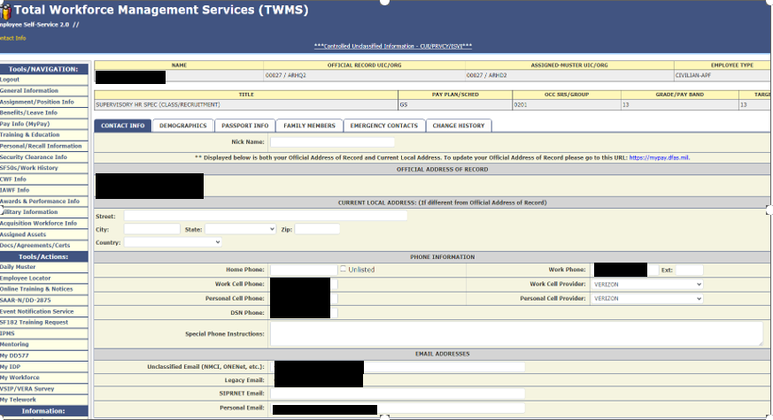
TWMS Screenshot

Slide 35
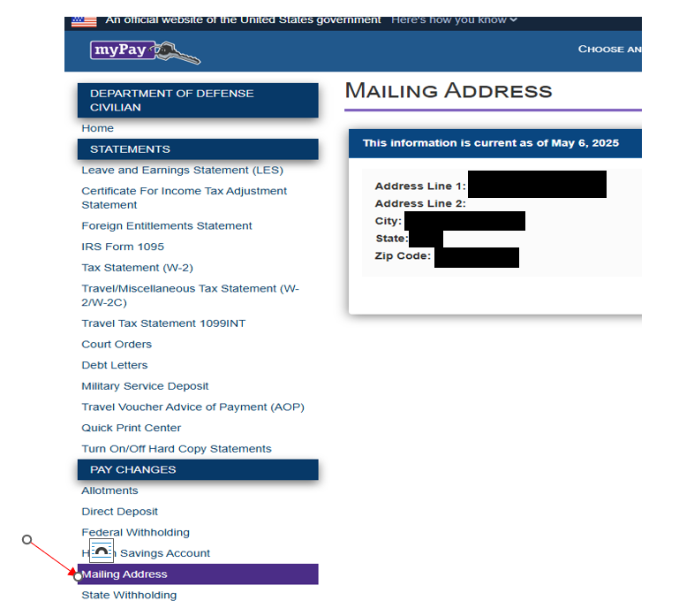
Updating / Changing
Mailing Address
To update your official address of record, this is done in MyPay at the following site:
https://mypay.dfas.mil

Slide 36
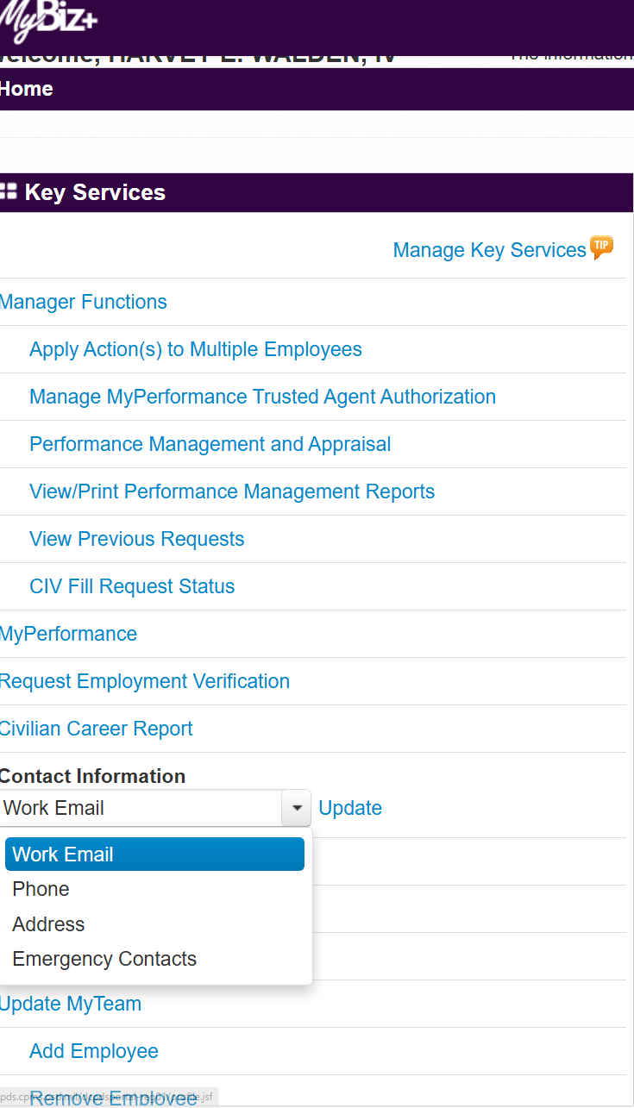
Updating / Changing
Emergency Contacts
To update Emergency Contact information, this is updated in MyBiz at the following site:
https://compo.dcpds.cpms.osd.mil
In the Key Services section, go to “Contact Information”.
A down arrow will appear, and you can select “Emergency Contacts” and select update.

Slide 37
Contact Information
Your 1st 90 Days – Contact the individual that provided you with your reporting instructions.
The Human Resources Team has permanent offices in the following locations:
Pentagon
Quantico, VA
Indianapolis, IN
New Orleans, LA
All teams can be reached at:
Email: SMB_HQMC_Staffing@usmc.mil or 703-614-8371
Notes:
Notes for your discretion:
All teams can be reached at the email provided at the bottom of this slide.

Slide 38

Questions

