Slide 1
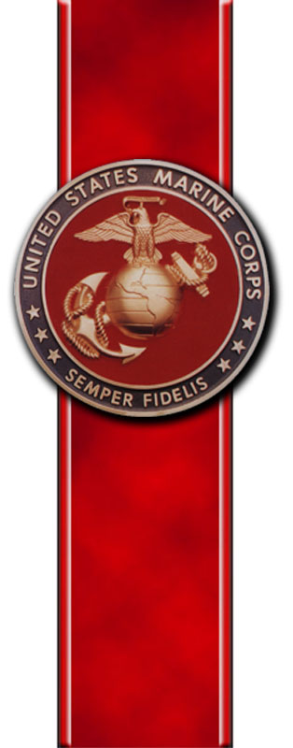
Headquarters Marine Corps, Henderson Hall Safety Welcome Aboard Civilian Marines

Slide 2
Safety Comments
To provide Marines, Sailors, Civilians and their families assigned to Headquarters Marine Corps and Henderson Hall with Ground Safety, Occupational Safety and Environmental Protection Programs and Services.
- BLUF – This Command Safety Office is your _end state_ for all safety requirements and programs.
- Command Safety Culture – 360 Degree Awareness
Director of Safety HQMC, Henderson Hall
- Henderson Hall Commander and DMCS
- CMC SD: Realignment of duties and responsibilities “Boots on the Ground” and / or oversight
- UICs 00027, 67353, 67925 (All DCs i.e. DCI, AVN, P&R, PP&O, CD&I, I&L, and M&RA)
- Pentagon, TSO (Indy, Kansas City) Fort Meade, MCB Quantico (WWR, JIFCO, MCOTEA)
703-614-1900, hnhl_safety@usmc.mil, Linkedin, 202-657-8377, Kenneth.Barnett@usmc.mil
Command HR Liaisons or Unit Safety Representatives (USR)
- MCB Quantico Safety
Training
- Load Lifting Equipment Programs, Supervisor Safety Awareness, USR, OSHA 10 and 30 hour, CPR, Back in the Saddle (BITS), 101 Critical Days of Summer Briefs, online safety training etc.
- MCB Quantico Safety
Mishap & Hazard Reporting
- Report all mishaps, near misses and hazards (There is no repercussions)
- Supervisor, Command HR Liaison or USR
- Supervisors Mishap and Near Miss Reporting Form
Promotional Materials.
- National Safety Councils Family Safety and Health Magazine: Disseminated throughout the command to include the Pentagon. Web link is also available (Weekly Gouge – Command Web App)
- “Safety Checks” new letters, training power points, Lessons Learned are disseminated via email
Quantico Safety will provide you with an overview of your RIGHTS AND RESPONSIBILITIES when it comes to federal regulations and the Marine Corps Safety Management System (SMS) **Applies to all HQMC Civilians**
Notes:
2

