Slide 1



Human Resources &
Organizational Management Branch (HROM)
Organizational and Workforce Management Section
(ARHM)

Slide 2
Organization Development

Slide 3

What is OD?
Organization Development is a form of behavioral science which plans, develops and reinforces organizational strategies, structures, and processes that improve an organization’s performance and overall health.

Slide 4
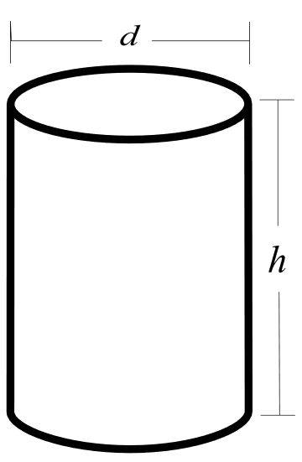
What We Do
Leadership Development
Change Management
Workforce Engagement
  Strategic Planning & Consultation
  Executive Decision-Making
  Culture Assessment
  Organization-wide Transitions
  Knowledge Management
  Process Improvement & Integration
  Team Development
  Performance Development
  Meeting/Off-site Design

Slide 5

Contact Us
Team Inbox:
SMB_HQMC_ARHM_OD@usmc.mil

Slide 6
Workforce Development

Slide 7


Workforce Development
We are here to be the best Civilian onsite, Leadership Development, and Administrative Community of Interest (COI) training provider in the US Marine Corps (USMC). To serve as the best training liaison to HQMC Civilian personnel, our training coordinators, USMC Installations, and other stakeholders who utilize the training and development services we provide.

Slide 8




Workforce Development
AIDE THE WORKFORCE
ADVISE
INSPIRE
DEVELOP
EDUCATE

Slide 9
Continuous Learning Model
WORKFORCE DEVELOPMENT
Exposure
Environment
Experience
Education
ADVISE
INSPIRE
DEVELOP
EDUCATE
BUILD, DEVELOP, AND IMPACT

Slide 10
Our Services
  Academic Degree Program (ADP)
    Tuition Assistance
    Accredited Degrees and Certificates
  Civilian Leadership Development Program (CLD)
  Strategic Training Advising
    Individual Development Plan (IDP)
    Mandatory Training Completion Analytics
    Career Mapping Services
  On-Site Training
    Competency-Based Training
    Retirement Courses
    Professional Development Classes
  Administration Community of Interest (COI)
  Marine Corps Acculturation Program (MCAP)

Slide 11
Next Steps…
Don’t miss:
Marine Corps Acculturation Program
(MCAP)
Complete your:
Introductory and Mandatory Training
Located in your Total Workforce Management System (TWMS) account

Slide 12
Additional Resources
ARHM Website
http://www.hqmc.marines.mil/hrom/OrganizationWorkforce.aspx
On-site Training Webpage
http://www.hqmc.marines.mil/hrom/SponsoredTraining.aspx
Online Training
- TWMS: https://twms.navy.mil/login.asp
- MARINE NET: https://www.marinenet.usmc.mil
- JOINT KNOWLEDGE ONLINE: http://jko.jten.mil/
- NAVY GENERAL LIBRARY: https://navy.libraryreserve.com
- DAU (acquisition): http://www.dau.edu
Communities of Interest
LINKEDIN LEARNING:
Contact your COI Manager for registration information

Slide 13
Contact Us
Workforce Development Unit
Pentagon Room 2C253
Phone: (703) 614-9088
Onsite Training
Email: SMB.HQMC.ARHB.TRNG@usmc.mil
Civilian Development Programs Administrator
Email: SMBHQMCCLDP@usmc.mil
Administrative Community of Interest
Email: SMB_HQMC_COI-ADMIN@usmc.mil

Slide 14

Thank You!

